Slide 1
Software Engineering

Slide 2
Chapter 2- Software Process

Slide 3
Incremental Model
Rather than deliver the system as a single delivery, the development and delivery is broken down into increments with each increment delivering part of the required functionality.
User requirements are prioritised, and the highest priority requirements are included in early increments.
Once the development of an increment is started, the requirements are frozen though requirements for later increments can continue to evolve.

Slide 4
Incremental development and delivery
Incremental Development
  Develop the system in increments and evaluate each increment before proceeding to the development of the next increment;
  Normal approach used in agile methods;
  Evaluation done by user/customer.
Incremental Delivery
  Deploy an increment for use by end-users;
  Difficult to implement for replacement systems as increments have less functionality than the system being replaced.

Slide 5
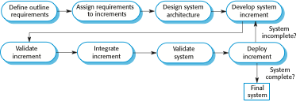
Incremental delivery

Slide 6
Incremental delivery advantages
Customer value can be delivered with each increment, so system functionality is available earlier.
Early increments act as a prototype to help elicit requirements for later increments.
Lower risk of overall project failure.

Slide 7
Incremental delivery problems
Most systems require a set of basic facilities that are used by different parts of the system.
  As requirements are not defined in detail until an increment is to be implemented, it can be hard to identify common facilities that are needed by all increments.
You don’t write the full specification at the start.
  However, this conflicts with the procurement model of many organizations, where the complete system specification is part of the system development contract.

Slide 8
Incremental delivery problems Cont
Example
Imagine you’re hired to build a university’s new student portal.
With incremental delivery, you’d first deliver login + registration, then attendance, then fee management, etc., refining requirements as you go.
But the university’s contract says: “We want a complete detailed requirement doc upfront (every single feature, UI design, reports, deadlines).”
Now you can’t follow incremental naturally, because the contract locks everything down.

Slide 9
Spiral Model
The Spiral Model is iterative, risk-driven, and delivers the system incrementally. Feedback is taken after each loop.
Each loop in the spiral represents a phase in the process.
No fixed phases such as specification or design - loops in the spiral are chosen depending on what is required.
Risks are explicitly assessed and resolved throughout the process.

Slide 10
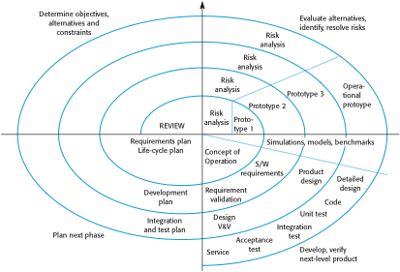
Spiral Model of the Software Process

Slide 11
Spiral Model Sectors
Objective setting
  Decide what to achieve in this cycle (features, requirements, goals).
Risk Assessment and Reduction
  Identify possible risks (technical, cost, schedule, usability).
  Try to reduce/eliminate them (e.g., building a prototype to test an idea).
Development and Validation
  Build the selected features (could be design, coding, or prototype).
  Test/validate against objectives.
Planning
  Review with stakeholders. Plan next cycle (what’s next in the spiral).

Slide 12
Advantages
Best for large, complex, high-risk projects.
Manages risks early and systematically.
Allows user feedback at every loop.
Flexible → can adapt to changes.

Slide 13
Disadvantages
Expensive (requires risk analysis experts).
Not good for small projects.
Can be difficult to manage.

Slide 14
Spiral Model Example
Objective Setting
Build a Secure Login Feature (Username + Password).
Goal: Allow users to safely access their accounts.
Risk Identification and Reduction
Passwords could be hacked (brute force / phishing).
Users may forget their passwords, leading to account lockouts.
Introduce Two-Factor Authentication (OTP on mobile/email).
Add a Password Reset Option with email/phone verification.

Slide 15
Spiral Model Example
Development + Validation
Prototype: Simple login screen (Username + Password + “Forgot Password?” link).
Validation: Show it to the client → confirm that login flow matches expectations.
Planning Next Iteration
Next cycle will add Transaction History Module.

Slide 16
Thank You

